Slide 1
ABRALOG/AFILOG
September 15, 2022
Joint members’ survey
What’s on your mind and how can we help?

Slide 2
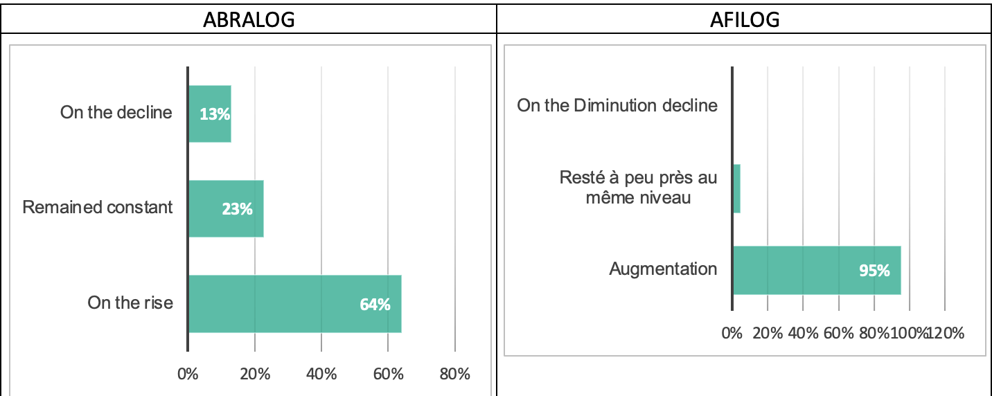
Turnover for past two years: increased!
64% of ABRALOG respondents and 95% of AFILOG respondents have seen their revenue increase for the past two years
Half of members attribute the changes to the pandemic

Slide 3
AFILOG members: very impacted by war in Ukraine
ABRALOG members: 63%, AFILOG members: 82% negatively impacted by war
Oil and materials cost increases, building prices, delays in decision-taking, lack of visibility, general disruption in global trade
One positive impact: increase in demand for inventory

Slide 4
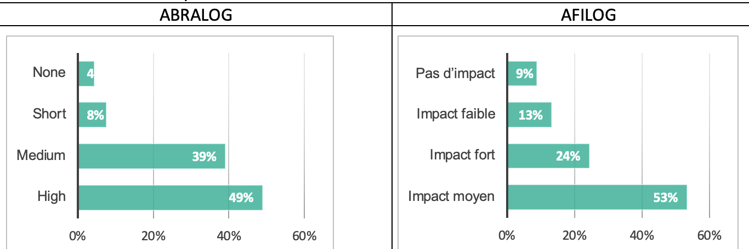
Inflation and high interest rates have a strong impact
« High impact » for 49% of Brazil respondents, « medium impact » for 53% of French respondents

Slide 5
Supply chain disruptions from COVID and Urkaine
Both crises have impacted business in numerous ways
Brazil: increase in logistics costs and price volatility
France: price volatility and delays in sourcing supplies
French feel harder the shortage of resources and parts
90% of French and 60% of Brazilians: difficult or very difficult to source materials since the war in Ukraine
A third of all respondents think energy supply has become extremely difficult
One thing that has not (yet) been affected by the Covid and Ukrainian crises, in both countries, has been the level of activity and sales
Sends a positive message about the sector

Slide 6
Developers, facility owners, investors’ specific challenges
In Brazil
finding land in peripheral areas
rising costs
In France
rising costs (all costs, from salaries to materials to land)
finding land in peripheral areas
delays in administrative process and upcoming legislation such as “net zero land artificialization”
One specific difficulty mentioned in France is finding land in urban areas

Slide 7
Constructors and general contractors’ challenges
In both countries:
Costs : land, materials, energy, salaries
Staff shortage
In France, land availability is also mentioned as a big issue
Facility users’ challengers
In both countries:
Rental costs especially in France
Other cost increases, especially in Brazil
In France, finding space including in urban areas

Slide 8
How does the situation lead to changes in the organization of the supply chain?
(eg near-shoring, sourcing supplies closer to home)
No clear answer
When they answer, most think that a better mix of near-shoring and far-shoring is required
Important to anticipate better, so that the supply chain is more resilient
Eg construction materials could be ordered with more lead-time
Energy mix will change for half of the respondents (and will not change for the other half)

Slide 9
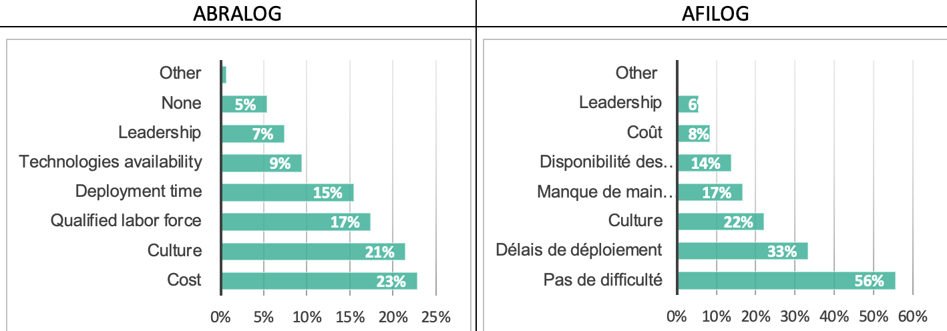
Degree of digitization and uptake of new technologies: progress can be made
49% in Brazil and 52% in France think it is rather good (uptake of 75% or above)
But a strong minority of companies think the uptake is at 50% or lower
Countries diverge in the expectations and challenges to digitalize more/better
In France: not so difficult but delays and resistance to change (“culture”)
In Brazil: costs and resistance to change (“culture”) are big problems
In both countries, lack of qualified labor for implementing new technologies

Slide 10
What new sources of energy?
 | Brazil | France
In warehouses | Photovoltaic Biomethane | Photovoltaic Biomethane (+ biomass and geothermal energy)
For transportation | Battery electric Hydrid fuels + Bio CNG | Battery electric Hybrid fuels + CNG, bio CNG, hydrogen

Slide 11
Labor shortages!
 | Brazil | France
Non-qualified | 36% | 50%
Qualified | 83% | 91%

Slide 12
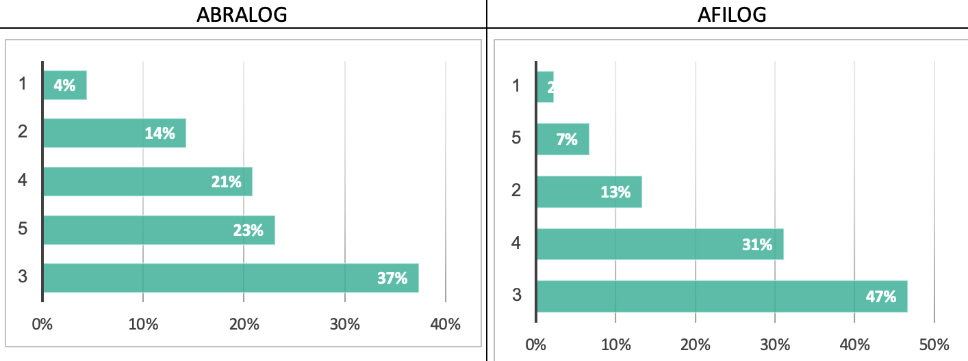
How do you see your company in two years?
ABRALOG (45%) and AFILOG (37%) members see themselves in a robust “4” or even “5” position in two years
A relative majority of French members (47%) prefer to see themselves as a “3”
Despite the current crises, very few members see themselves in a poor situation

Slide 13
How can ABRALOG and AFILOG help?
Monitoring on macroeconomics and regulatory changes, identifying market changes, and providing information and data
Organization of events, including training events
Lobbying on current policies and new regulation such as French "ZAN”
Promotion of the logistics real estate business among the general public and public authorities, initiatives to attract new labor force
Partnership between ABRALOG and AFILOG “adds value to both entities and members”

Slide 14
Laetitia Dablanc University Gustave Eiffel, Paris
laetitia.dablanc@univ-eiffel.fr
Diana Diziain AFILOG
diana.diziain@afilog.org
Pedro Moreira ABRALOG
pedro.moreira@abralog.com.br
Hugo Yoshizaki University of Sao Paulo
hugo@usp.br

